Slide 1
Chapter 4 The Interaction
-Interaction is Communication between user and system.
interaction models
translations between user and system
ergonomics
physical characteristics of interaction
interaction styles
the nature of user/system dialog
Context
- social, organizational, motivational
Paradigm

Slide 2
Some terms of interaction
domain – defines an area of expertise and knowledge in
some real-world activity.
e.g. graphic design
task – how you go about doing it. – operations to manipulate the concepts of a domain. e.g. … select fill tool, click over triangle
goal – the desired output from a performed task.
– what you want to achieve.
e.g. create a solid red triangle
intention - is a specific action required to meet the goal.

Slide 3
Donald Norman’s model
The interactive cycle can be divided into two major phases: execution and evaluation. These can then be subdivided into further stages, seven in all.
Seven stages
Establishing the goal.
Forming the intention.
Specifying the action sequence.
Executing the action.
Perceiving the system state.
Interpreting the system state.
Evaluating the system state with respect to the goals and intentions.
Norman’s model concentrates on user’s view of the interface. It does not deal with the system’s communication through the interface.

Slide 4
Execution/evaluation loop
goal
user establishes the goal
formulates intention
specifies actions at interface
executes action
perceives system state
interprets system state
evaluates system state with respect to goal
execution
evaluation
system

Slide 5
execution/evaluation loop
goal
user establishes the goal
formulates intention
specifies actions at interface
executes action
perceives system state
interprets system state
evaluates system state with respect to goal
execution
evaluation
system

Slide 6
execution/evaluation loop
goal
user establishes the goal
formulates intention
specifies actions at interface
executes action
perceives system state
interprets system state
evaluates system state with respect to goal
execution
evaluation
system

Slide 7
execution/evaluation loop
goal
user establishes the goal
formulates intention
specifies actions at interface
executes action
perceives system state
interprets system state
evaluates system state with respect to goal
execution
evaluation
system

Slide 8
Using Norman’s model
Some systems are harder to use than others
Gulf of Execution
user’s formulation of actions to reach the goal ≠ actions allowed by the system
Gulf of Evaluation
physical presentation of the system state ≠ the expectation of the user

Slide 9
Abowd and Beale framework
extension of Norman…
their interaction framework has 4 parts
user
input
system
output
each has its own unique language interaction ⇒ translation between languages
problems in interaction = problems in translation
O
output
S
core
U
task
I
input

Slide 10
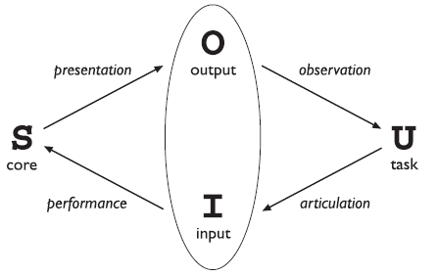
Abowd and Beale framework

Slide 11
Using Abowd & Beale’s model
User intentions → translated into actions at the interface → translated into alterations of system state → reflected in the output display → interpreted by the user
General framework for understanding interaction
not restricted to electronic computer systems
identifies all major components involved in interaction
allows comparative assessment of systems
an abstraction

Slide 12
Ergonomics
Study of the physical characteristics of interaction
Also known as human factors – but this can also be used to mean much of HCI!
Ergonomics good at defining standards and guidelines for constraining the way we design certain aspects of systems.

Slide 13
Ergonomics - examples
arrangement of controls and displays
e.g. controls grouped according to function or frequency of use, or sequentially
surrounding environment
e.g. seating arrangements adaptable to cope with all sizes of user
health issues
e.g. physical position, environmental conditions (temperature, humidity), lighting, noise,
use of colour
e.g. use of red for warning, green for okay, awareness of colour-blindness etc.

Slide 14
Common interaction styles
command line interface
menus
natural language
question/answer and query dialogue
form-fills and spreadsheets
WIMP
point and click
three–dimensional interfaces

Slide 15
Command line interface
Way of expressing instructions to the computer directly
function keys, single characters, short abbreviations, whole words, or a combination
suitable for repetitive tasks
better for expert users than novices
offers direct access to system functionality
command names/abbreviations should be meaningful!
Typical example: the Unix system

Slide 16
Menus
Set of options displayed on the screen
Options visible
less recall - easier to use
rely on recognition so names should be meaningful
Selection by:
numbers, letters, arrow keys, mouse
combination (e.g. mouse plus accelerators)
Often options hierarchically grouped
sensible grouping is needed
Restricted form of full WIMP system

Slide 17
Natural language
Familiar to user
speech recognition or typed natural language
Problems
vague
ambiguous
hard to do well!
Solutions
try to understand a subset
pick on key words

Slide 18
Query interfaces
Question/answer interfaces
user led through interaction via series of questions
suitable for novice users but restricted functionality
often used in information systems
Query languages (e.g. SQL)
used to retrieve information from database
requires understanding of database structure and language syntax, hence requires some expertise

Slide 19
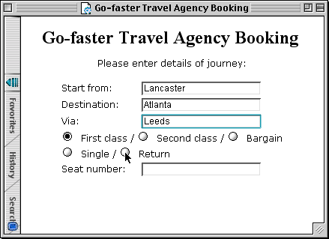
Form-fills
Primarily for data entry or data retrieval
Screen like paper form.
Data put in relevant place
Requires
good design
obvious correction facilities

Slide 20
Spreadsheets
first spreadsheet VISICALC, followed by Lotus 1-2-3 MS Excel most common today
sophisticated variation of form-filling.
grid of cells contain a value or a formula
formula can involve values of other cells e.g. sum of all cells in this column
user can enter and alter data spreadsheet maintains consistency

Slide 21
WIMP Interface
Windows
Icons
Menus
Pointers
… or windows, icons, mice, and pull-down menus!
default style for majority of interactive computer systems, especially PCs and desktop machines

Slide 22
Point and click interfaces
used in ..
multimedia
web browsers
hypertext
just click something!
icons, text links or location on map
minimal typing

Slide 23


Three dimensional interfaces
virtual reality
‘ordinary’ window systems
highlighting
visual affordance
indiscriminate use just confusing!
3D workspaces
use for extra virtual space
light and occlusion give depth
distance effects
flat buttons …
click me!
… or sculptured

Slide 24
Windows
Areas of the screen that behave as if they were independent
can contain text or graphics
can be moved or resized
can overlap and obscure each other, or can be laid out next to one another (tiled)
scrollbars
allow the user to move the contents of the window up and down or from side to side
title bars
describe the name of the window

Slide 25
Icons
small picture or image
represents some object in the interface
often a window or action
windows can be closed down (iconized)
small representation of many accessible windows
icons can be many and various
highly stylized
realistic representations.

Slide 26
Pointers
important component
WIMP style relies on pointing and selecting things
uses mouse, trackpad, joystick, trackball, cursor keys or keyboard shortcuts
wide variety of graphical images

Slide 27
Menus
Choice of operations or services offered on the screen
Required option selected with pointer
problem – take a lot of screen space
solution – pop-up: menu appears when needed

Slide 28
understanding and choosing widgets
It is individual items on a GUI screen ...
checkboxes, menus, toolbars, buttons etc.
three aspects:
appearance - what they look like
interaction - how they behave
semantics - what they mean

Slide 29
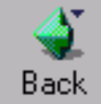
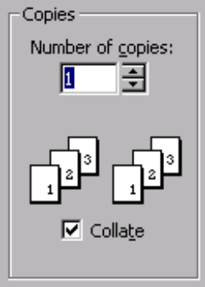
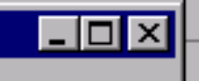

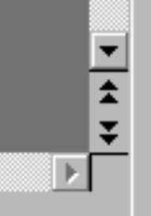


appearance

Slide 30
appearance includes words
verbs - action words
quit, exit, embolden, italicise
adjectives - description/state words
bold, italic
nouns - usually as a form of description
Times New Roman, US Letter
beware of mixes …
embolden + italic !!?!

Slide 31
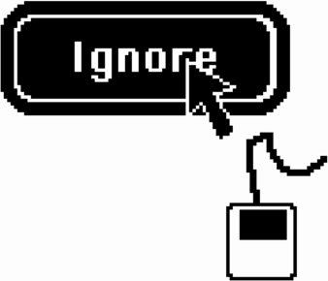
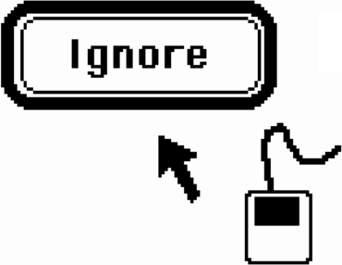
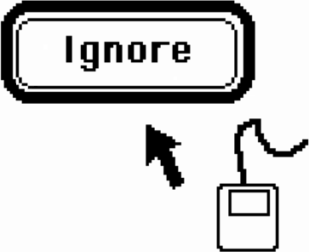
behavior
Move mouse over button – highlights
Move mouse off target with button still down – highlight removed
Release mouse – nothing happens

Slide 32
behavior … ctd.
some bits the toolkit does for you
but is it right?
some you control
e.g. drawing, interactions between widgets
beware timing issues
e.g. large selections under Windows apps.

Slide 33
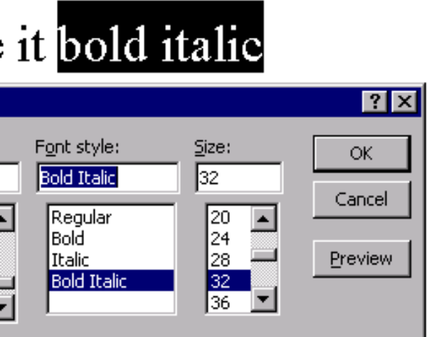
semantics
menus, buttons, …, etc.
do things …
… lets make it bold italic

Slide 34
YOU say what it means
semantics usually up to you
although widgets may link direct to database
even then, you say what links
think separately:
meaning first - what you want it to do
then appearance - how you do it
choose the widget for the job
what do you want?
How many?

Slide 35
Thank you

